Slide 1
Reverse Archeology Dig
Using coordinate mapping and stratigraphy
to understand context of an archeological dig unit.

Slide 2
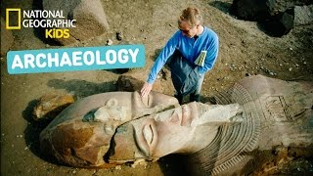
What is Archeology

Slide 3
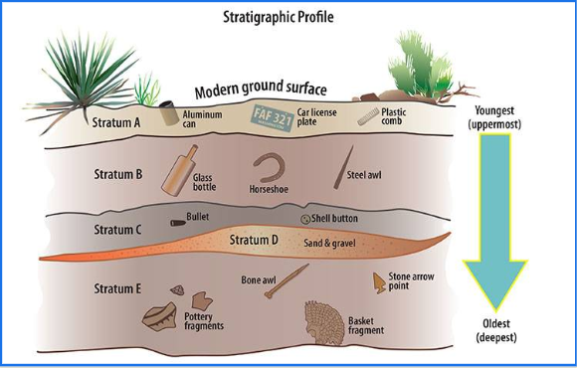
What is Stratigraphy?
Why is it important?

Slide 4
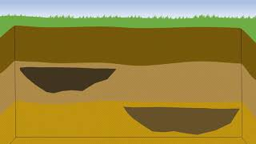
More about Stratigraphy

Slide 5
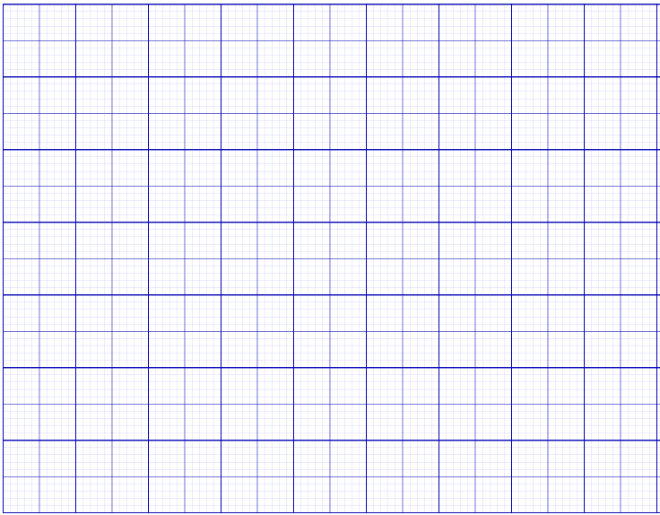

Create a grid
(0,0)

Slide 6
Label the Grid
(0,10)
Datum point (origin)
(0,0)
(10,0)

Slide 7
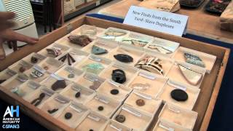
Artifacts found - Slave Quarters

Slide 8
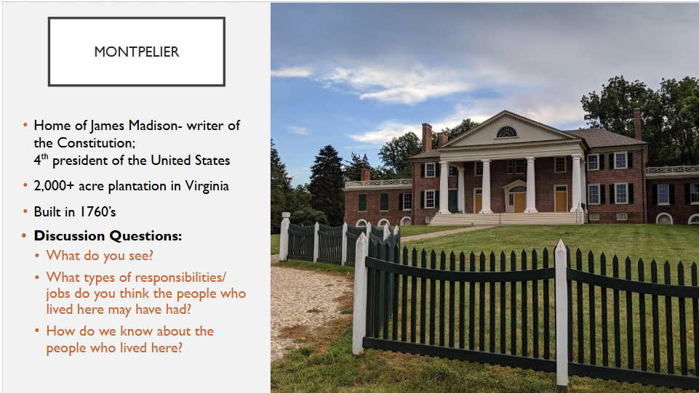
Montpelier

Slide 9
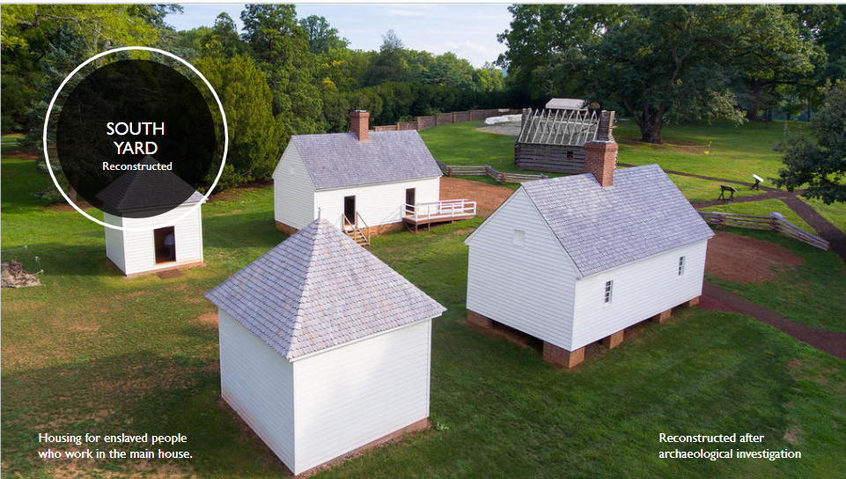
South Yard Reconstructed

Slide 10
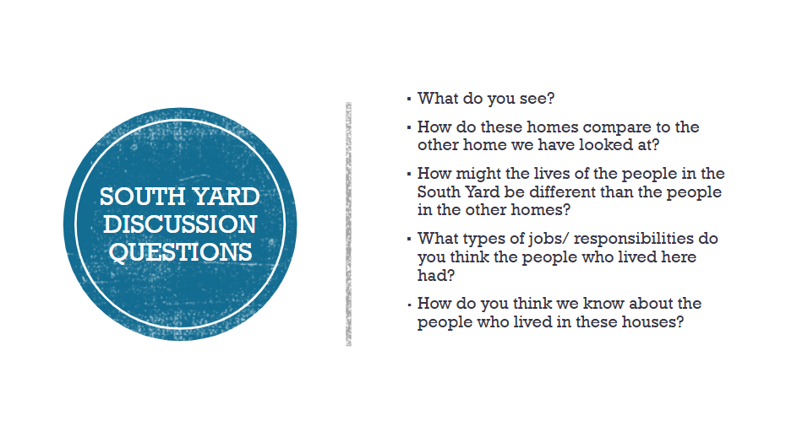
South Yard Discussion Questions

Slide 11
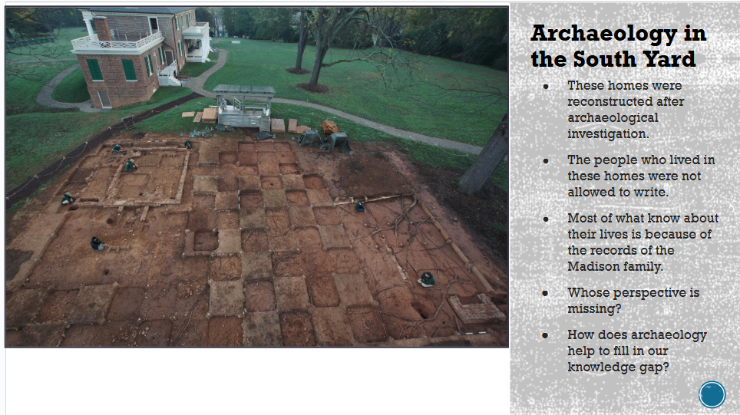
Archaeology in the South Yard

Slide 12
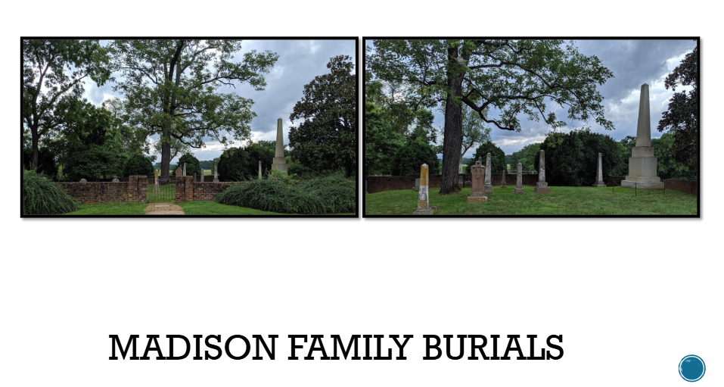
Madison Family Burials

Slide 13
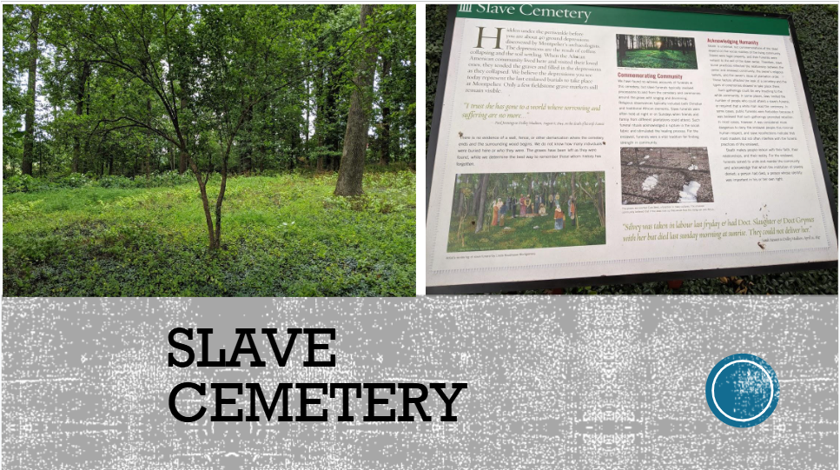
Slave Cemetery

Slide 14
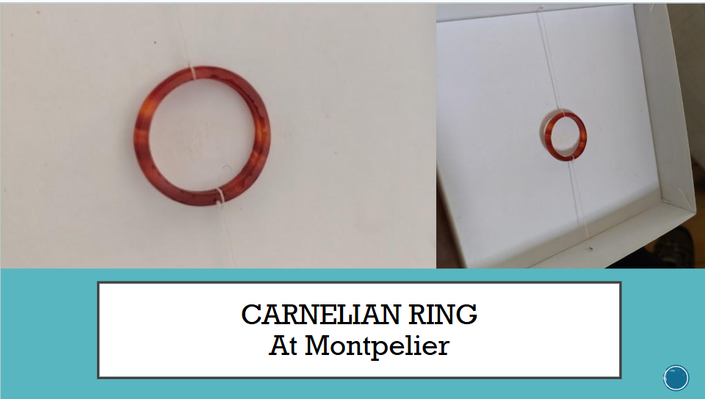
Carnelian Ring at Montpelier

Slide 15
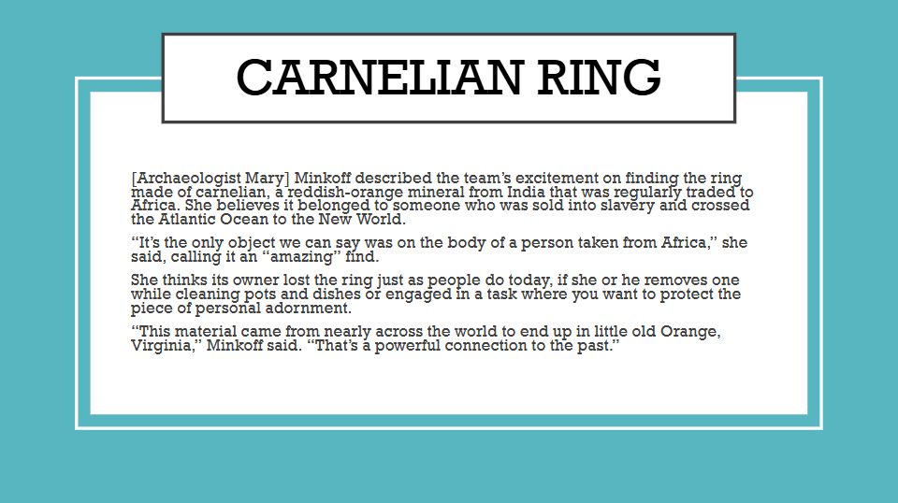
Carnelian Ring

Slide 16
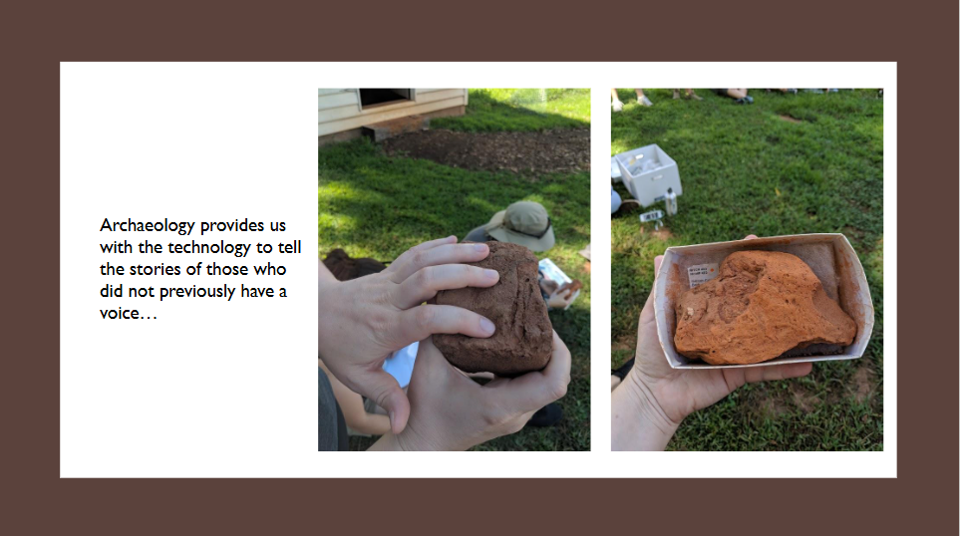
What does archaeology provide us with?

