Slide 1
The House on Mango Street by Sandra Cisneros
From Trowels To Teaching

Slide 2
Learning Standards and Objectives
RL.8.1 Cite the textual evidence that most strongly supports an analysis of what the text says explicitly as well as inferences drawn from the text.
RI.8.6 Determine an author's point of view or purpose in a text and analyze how the author acknowledges and responds to conflicting evidence or viewpoints.
Students will be able analyze the main character Esperanza and how she comes to interpret the meaning of home in her own words.
Students will be able to to explore and analyze the message that Sandra Cisneros is sharing about the meaning of home through various characters that take part in this excerpt.

Slide 3
How does this include archaeology?
This excerpt talks about the meaning of home and how it can take on many different viewpoints depending on the individual person.
Questions To Help Us Think:
What does a home mean to you?
What items (artifacts) can be placed in a home that represent who you are? What stories do they tell?
What lessons can we learn from viewing the home of where someone lives?
How do people analyze the homes of others through language?

Slide 4
Before We Read!

Slide 5

Let’s Draw- Your Dream House!
What does your dream house look like to you?
What do you have inside your house?

Slide 6

Think-Pair-Share
After you complete your drawing, take time to share your dream house with a classmate!
Questions To Help You Think!
What makes your house special to you?
What items (artifacts) did you select to be inside your house? What does that say about you?

Slide 7
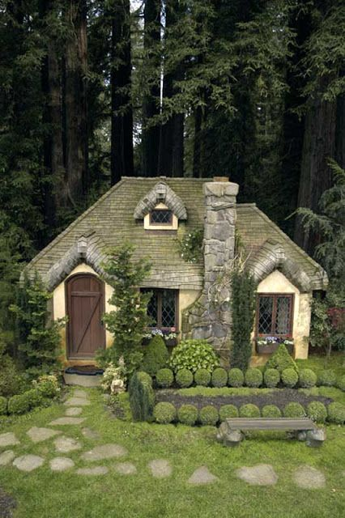





Ms. Green’s Dream Home! What artifacts do you recognize? What story do they tell?

Slide 8

The House On Mango Street by Sandra Cisneros
Let’s Talk:
What do you notice from the cover of the story?
What colors do you notice? How does that impact the cover of the story?
What do you think the story will be about?

Slide 9

Let’s Read: The House On Mango Street
As you read the text, please be on the lookout for the following:
Find and highlight the various characters and how they describe a “house” of their dreams.
How does their viewpoint impact other people?

Slide 10
Learning Activities!

Slide 11


The Importance of Artifacts
Artifacts are objects that tell archaeologists how people lived.
The home that you live in and the items that you have within your home can also be viewed as artifacts.
Artifacts can be found in many different ways. (Examples: Clothing, kitchen dishes, and buildings)

Slide 12
I Found an Old Artifact! Now What?
Step 1: Leave it where you found it!
Step 2:Download the phone app MDFind so that you can fill out important information for archaeologists to review what you found!

Slide 13
The Artifacts within The House on Mango Street
As we read The House on Mango Street, let’s be on the lookout for artifacts and why they are important.

Slide 14
Let’s Practice Looking for Artifacts!
Line 1-They always told us that one day we would move into a house, a real house that would be ours for always so we wouldn't have to move each year. And our house would have running water and pipes that worked.
What artifacts (items) did we discover from this opening line?
What are you able to notice that stands out to you?

Slide 15
Let’s Practice Looking for Artifacts!
Line 1-They always told us that one day we would move into a house, a real house that would be ours for always so we wouldn't have to move each year. And our house would have running water and pipes that worked.
What artifacts (items) did we discover from this opening line?
What are you able to notice that stands out to you?

Slide 16
Line 2- What are we learning about the house that Esperanza lives in with her family?
But the house on Mango Street is not the way they told it at all. It's small and red with tight steps in front and windows so small you'd think they were holding their breath. Bricks are crumbling in places, and the front door is so swollen you have to push hard to get in. There is no front yard, only four little elms the city planted by the curb.
Draw a picture of the house that Esperanza describes in this passage.
What is something that stands out to you about her house?
What artifacts did you find from this reading passage?

Slide 17
Line 2- What are we learning about the house that Esperanza lives in with her family?
But the house on Mango Street is not the way they told it at all. It's small and red with tight steps in front and windows so small you'd think they were holding their breath. Bricks are crumbling in places, and the front door is so swollen you have to push hard to get in. There is no front yard, only four little elms the city planted by the curb.
Draw a picture of the house that Esperanza describes in this passage.
What is something that stands out to you about her house?
What artifacts did you find from this reading passage?

Slide 18
Line 2- After reading this passage, draw an image in connection to what is being shared.
Out back is a small garage for the car we don't own yet and a small yard that looks smaller between the two buildings on either side.
Think- Pair-Share
Why do you think Esperanza is sharing these details with us about her home?
Does Esperanza have a positive or negative viewpoint of her home?
What is the impact of her home being surrounded by two buildings?
What artifacts did you find from this reading passage?

Slide 19
Line 2- Draw a layout of this description that Esperanza shares with us.
There are stairs in our house, but they're ordinary hallway stairs, and the house has only one washroom. Everybody has to share a bedroom—Mama and Papa, Carlos and Kiki, me and Nenny.
Think- Pair- Share
What are you learning about the house that Esperanza lives in with her family?
What is the impact of this unique living situation? What are you learning about from this family situation?
What artifacts did you find from this reading passage?

Slide 20
Line 2- Draw a layout of this description that Esperanza shares with us.
There are stairs in our house, but they're ordinary hallway stairs, and the house has only one washroom. Everybody has to share a bedroom—Mama and Papa, Carlos and Kiki, me and Nenny.
Think- Pair- Share
What are you learning about the house that Esperanza lives in with her family?
What is the impact of this unique living situation? What are you learning about from this family situation?
What artifacts did you find from this reading passage?

Slide 21
Looking At The Past

Slide 22
Line 3- Draw a picture of this area that Esperanza describes. What is unique about this area from her new home?
Once when we were living on Loomis, a nun from my school passed by and saw me playing out front. The laundromat downstairs had been boarded up because it had been robbed two days before and the owner had painted on the wood YES WE'RE OPEN so as not to lose business.
Think- Pair- Share-
What can you infer about this area of living just from the description that Esperanza shares with us?
What are you able to notice from this description that Esperaza shares with us?
What artifacts did you find from this reading passage?

Slide 23
Line 3- Draw a picture of this area that Esperanza describes. What is unique about this area from her new home?
Once when we were living on Loomis, a nun from my school passed by and saw me playing out front. The laundromat downstairs had been boarded up because it had been robbed two days before and the owner had painted on the wood YES WE'RE OPEN so as not to lose business.
Think- Pair- Share-
What can you infer about this area of living just from the description that Esperanza shares with us?
What are you able to notice from this description that Esperaza shares with us?
What artifacts did you find from this reading passage?

Slide 24
Line 3- What are we learning about the nun that questions where Esperanza lives? Why do you think she talks this way towards her?
Draw an image of the house that Esperanza describes as her old house.
Where do you live? she asked. There, I said pointing up to the third floor. You live there? There. I had to look to where she pointed—the third floor, the paint peeling, wooden bars Papa had nailed on the windows so we wouldn't fall out. You live there? The way she said it made me feel like nothing.

Slide 25
Line 3- What are we learning about the nun that questions where Esperanza lives? Why do you think she talks this way towards her?
Draw an image of the house that Esperanza describes as her old house.
Where do you live? she asked. There, I said pointing up to the third floor. You live there? There. I had to look to where she pointed—the third floor, the paint peeling, wooden bars Papa had nailed on the windows so we wouldn't fall out. You live there? The way she said it made me feel like nothing.

Slide 26
The House on Mango Street vs. The House on Loomis Street

Slide 27
The House on Mango Street Vs. The House on Loomis Street
Directions:
Step 1- Review your two drawings showcasing the homes that Esperanza lives in with her family.
Step 2- Create a list that shares what they have in common vs what they do not have in common.

Slide 28

Author Conversation- Sandra Cisneros
After reading this excerpt of The House on Mango Street, write down three questions that you have about this reading passage.

Slide 29
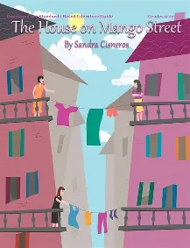


The House On Mango Street by Sandra Cisneros
Let’s Brainstorm:
Look at the various covers of Sandra Cisneros famous novel: what kind of imagery is being presented to the reader?
What is the message that is being showcased to inform the reader?

Slide 30

The Writing Prompt!
What message is the author Sandra Cisneros communicating through Esperanza in connection to the artifacts that are portrayed within the story? Locate three artifacts from the text and analyze the messages that they present.

