Slide 1
Who are American Indians today?
• Analyzing the role of native sovereignty in contemporary law.

Slide 2

WARM UP
What do you think or know the word “sovereignty” means? Try using it in a sentence or drawing an image.

Slide 3

DEFINED
sovereignty - noun
noun: sovereignty
supreme power or authority.: "how can we hope to wrest sovereignty away from the oligarchy and back to the people?".
synonyms: jurisdiction, supremacy, dominion, power, ascendancy, suzerainty, tyranny, hegemony, domination, sway, predominance, authority, control, influence, rule, raj, regiment

Slide 4
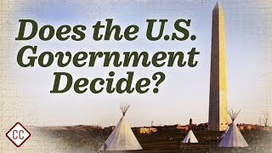
Now that we have defined “sovereignty” what do you think TRIBAL SOVEREIGNTY might mean?

Slide 5
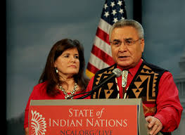


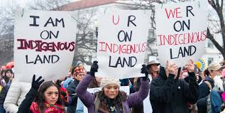
Indigenous land rights

Slide 6
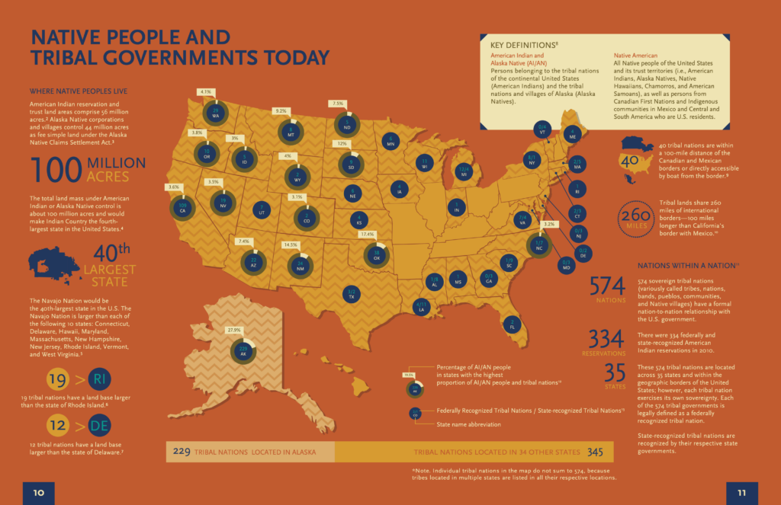
Native People and tribal governments today

Slide 7
The Role of Native Sovereignty in Contemporary Law:
Native sovereignty, also known as tribal sovereignty, is the inherent right of American Indian and Alaska Native tribes to govern themselves within the borders of the United States. It's a cornerstone of federal Indian law and policy, shaping the unique relationship between tribal governments and the U.S. government.

Slide 8
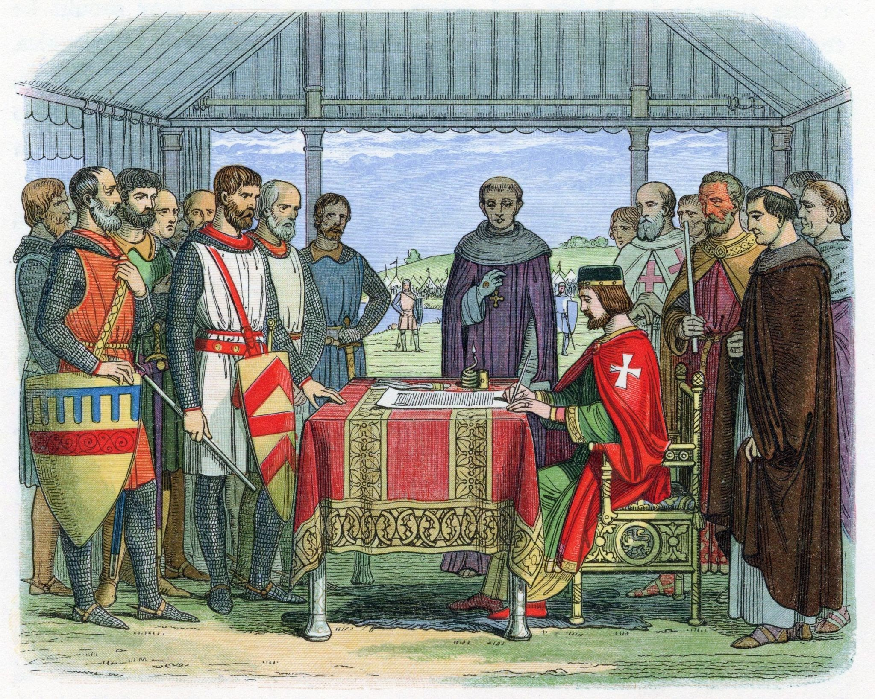
Key aspects of Native sovereignty in contemporary law:
Self-governance: Tribes have the authority to establish and maintain their own governmental structures, including determining membership, enacting and enforcing laws within their jurisdiction, conducting elections, and choosing leadership.

Slide 9
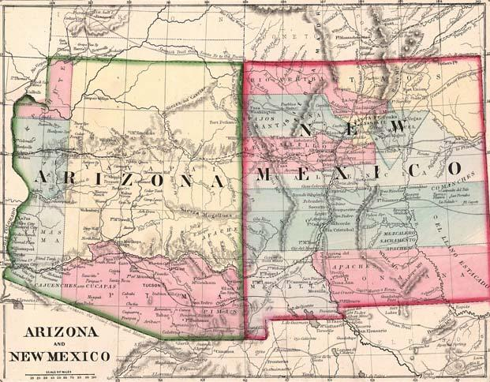
Key aspects of Native sovereignty in contemporary law:
Territorial jurisdiction: Tribal governments exercise control over lands within their reservation boundaries, regulating activities like zoning, land use, and managing natural resources.

Slide 10
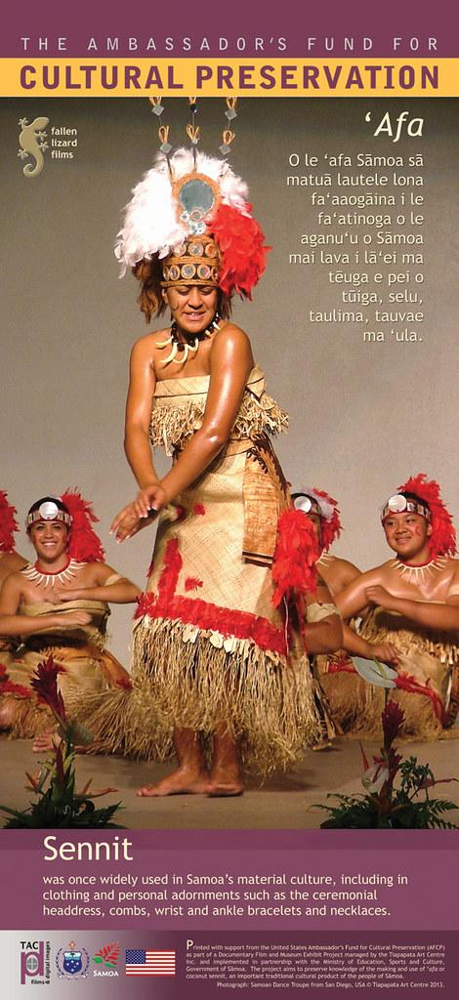
Key aspects of Native sovereignty in contemporary law:
Cultural Preservation: Sovereignty enables tribes to protect and practice their traditions, languages, and customs. They can establish educational systems that preserve culture and language, control cultural property and sacred sites, and repatriate cultural artifacts and remains.

Slide 11
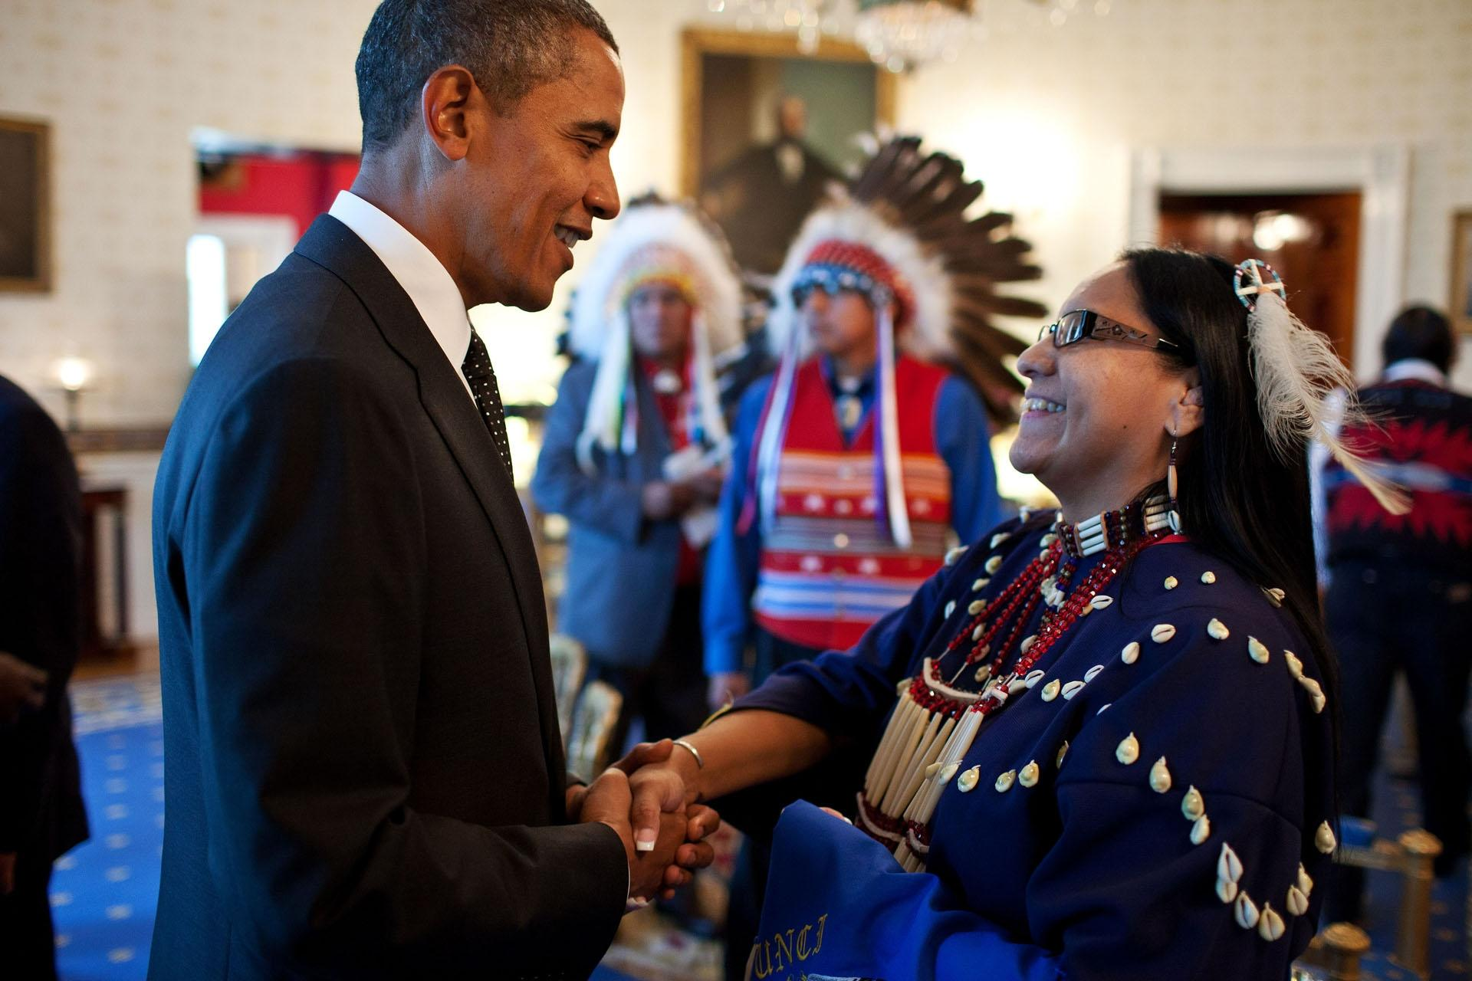
Key aspects of Native sovereignty in contemporary law:
Tribal Courts: Tribes can establish and operate their own judicial systems to handle civil and some criminal cases based on tribal laws and customs.

Slide 12
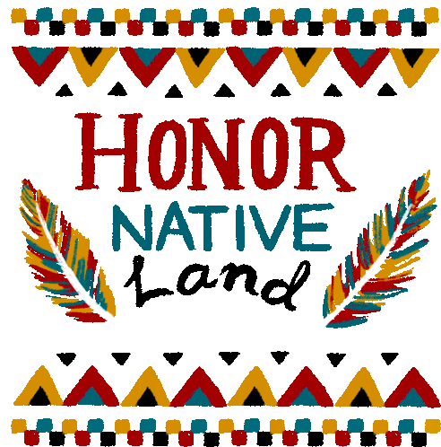
Key aspects of Native sovereignty in contemporary law:
Economic Development: Tribes have the power to create and regulate businesses within their territories, negotiate partnerships, and leverage their sovereign status for economic benefits.

Slide 13
Legal Basis and Evolution:
U.S. Constitution: The Constitution recognizes tribes as distinct political entities and grants Congress authority in Indian affairs.
Treaties: Early treaties established government-to-government relationships, recognizing tribes as sovereign entities and outlining rights and federal protections.
Supreme Court Decisions: Landmark cases like the "Marshall Trilogy" (Johnson v. McIntosh, Cherokee Nation v. Georgia, Worcester v. Georgia) defined tribes as "domestic dependent nations" with inherent, but sometimes limited, sovereignty. Cases like United States v. Wheeler (1978) reaffirmed the inherent sovereignty of tribes.
Congressional Acts: Laws like the Indian Reorganization Act of 1934 and the Indian Self-Determination and Education Assistance Act of 1975 have acknowledged inherent tribal sovereignty and promoted self-governance

Slide 14
Contemporary Challenges and Issues:
Jurisdictional Disputes: Conflicting jurisdictions between tribal, federal, and state authorities, particularly concerning crimes committed on tribal lands by non-Natives, remain a significant challenge. The Supreme Court's decision in Oklahoma v. Castro-Huerta (2022) highlighted these challenges.
Federal Funding: Tribes often lack adequate federal funding and resources for essential services, including law enforcement and tribal courts, which can impede their ability to fully exercise their sovereignty.
Historical Legacy: The legacy of colonization, forced assimilation, and discriminatory policies continues to impact tribal sovereignty and governance.
Violence Against Native Women: Jurisdictional complexities can create challenges in prosecuting violence against Native women.
State Encroachment: States have attempted to assert jurisdiction over tribal matters, but federal court rulings have generally upheld tribal sovereignty.

Slide 15

Your turn to discover more!
https://journalistsresource.org/politics-and-government/tribal-sovereignty-native-americans/
Read the article - What’s tribal sovereignty and what does it mean for Native Americans?

Slide 16

Checking for Understanding
Use the link, make a copy of the document and type your responses. Then share your responses with Mr. Yates.
https://docs.google.com/document/d/1Tvy87VYt_-hY27g1r0b-YYKIFEyur2aBfpAD82LGLJQ/edit?usp=sharing

Slide 17

Exit Ticket
Why do you think there is still confusion or disagreement about tribal sovereignty between tribal nations and state governments?

