Slide 1

WELCOME!
FY27 Speaker Adrienne A. Jones African American Heritage Preservation Program
Non-Capital Grant Webinar

Slide 2
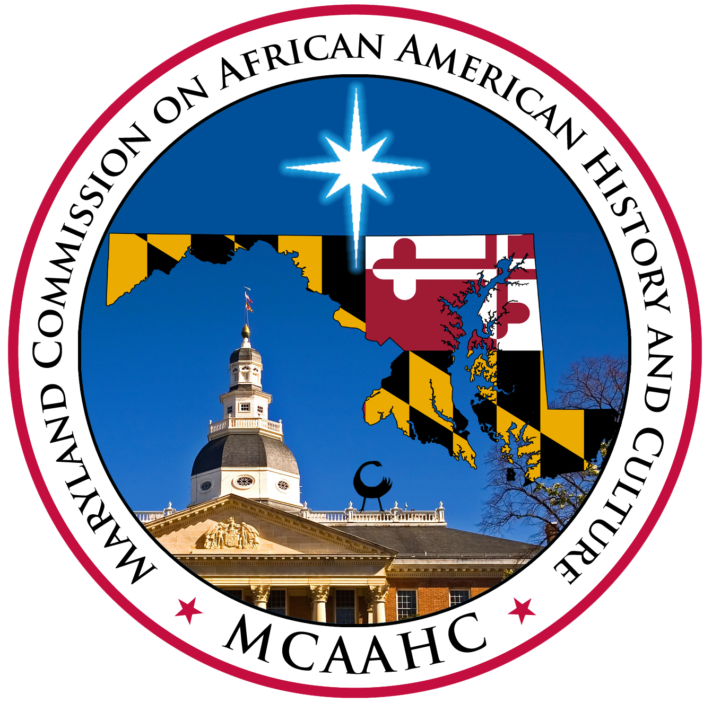

Program Background
Grant invests in people, planning, and community programs
Projects must contribute to Maryland’s African American history and culture
$250,000 available this year

Slide 3
Application Deadline
You must submit your online application online by
11:59 pm EST on
November 20, 2026

Slide 4
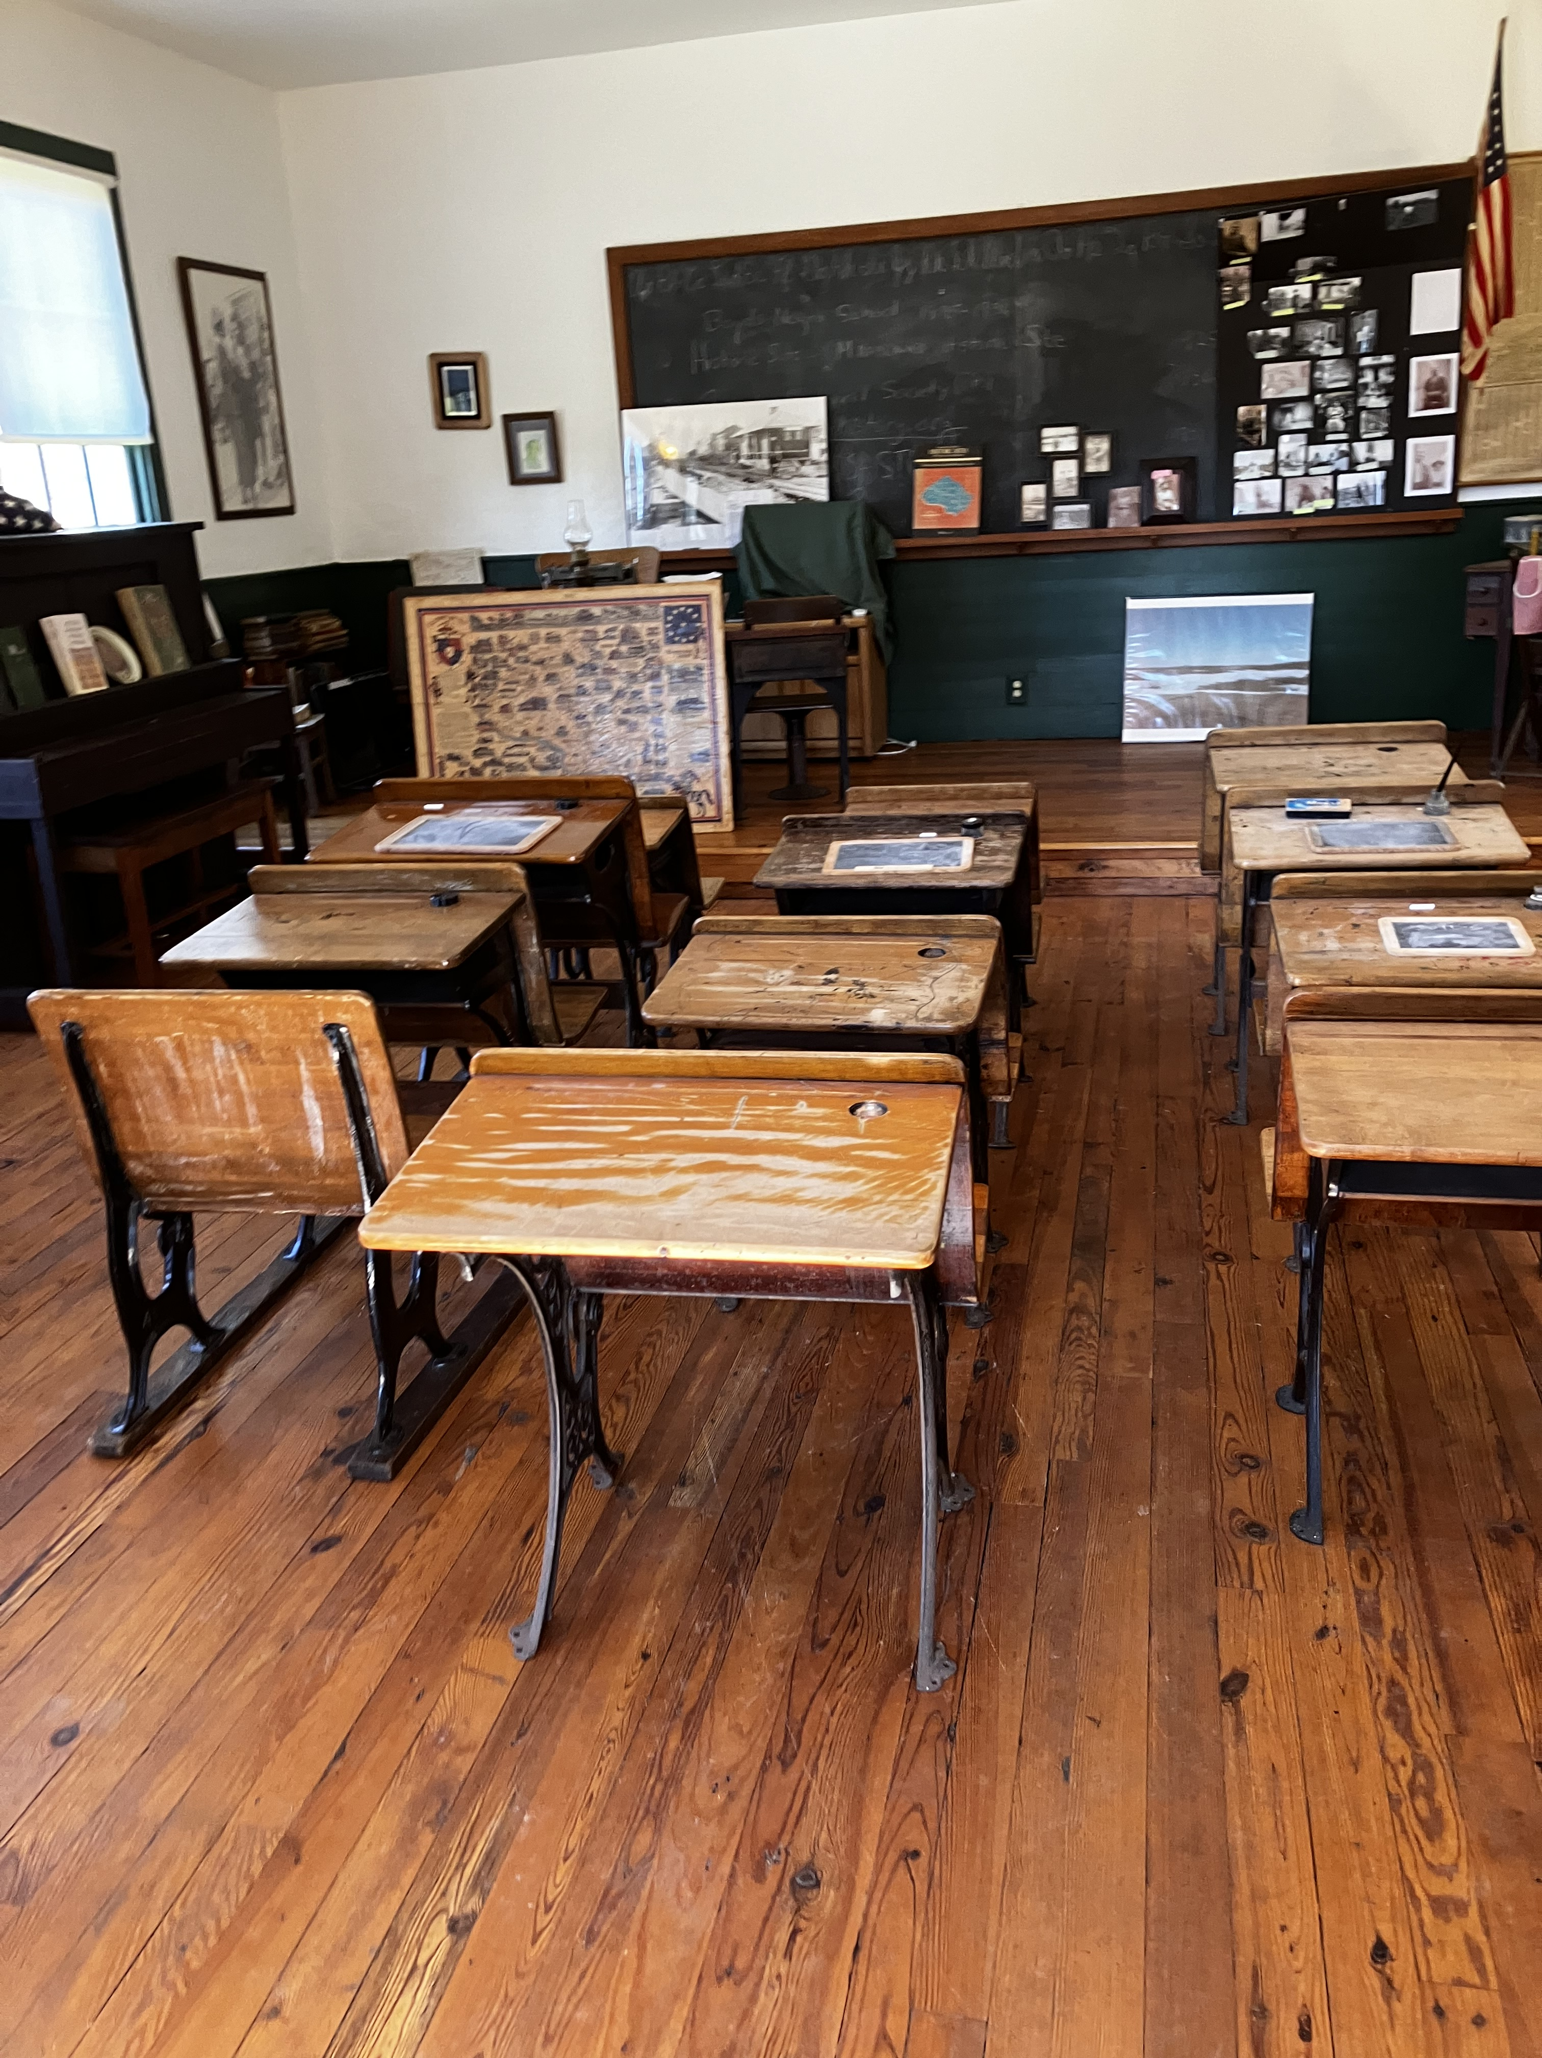
Eligible Applicants
Non-profit organizations
Local governments
State and Federal agencies
Businesses
Individuals
All Applicants (except individuals) must be registered and in good standing with SDAT https://egov.maryland.gov/BusinessExpress/EntitySearch.
All Non-Profit Organizations must be registered with Maryland's Secretary of State: https://onestop.md.gov/list_views/62f3e1797f7e3200016a3dab
Applicants must provide organizational documents, including Bylaws, Articles of Incorporation, and proof of non-profit status from the IRS.
Boyds Negro School, Montgomery County

Slide 5
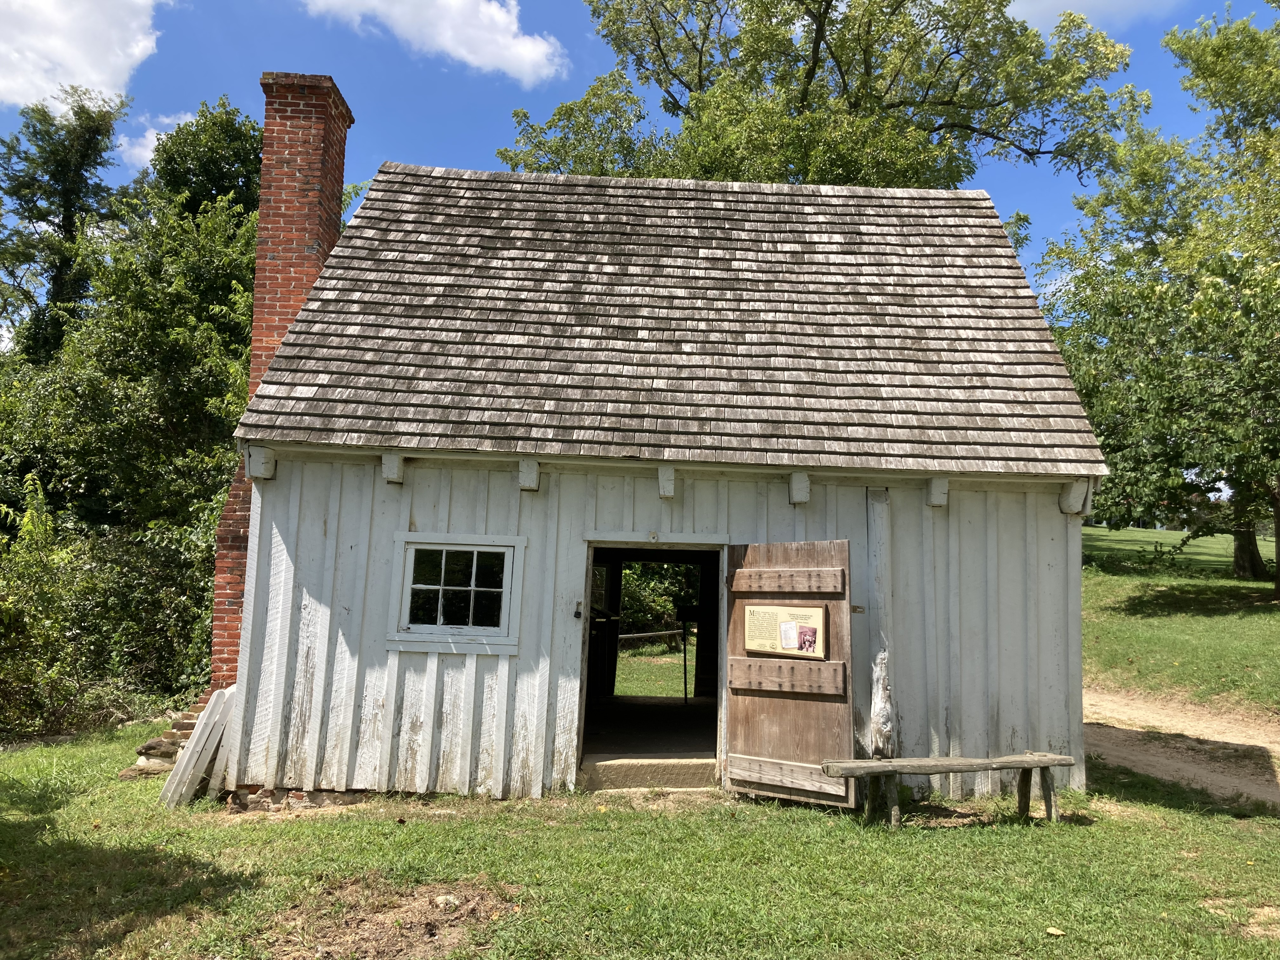
Eligible Activities
All Projects Must:
Be located in Maryland
Have a clear, documented connection to African American history, culture, or heritage
Be carried out within 12 months
Slave Dwelling at Sotterley, St. Mary's County

Slide 6
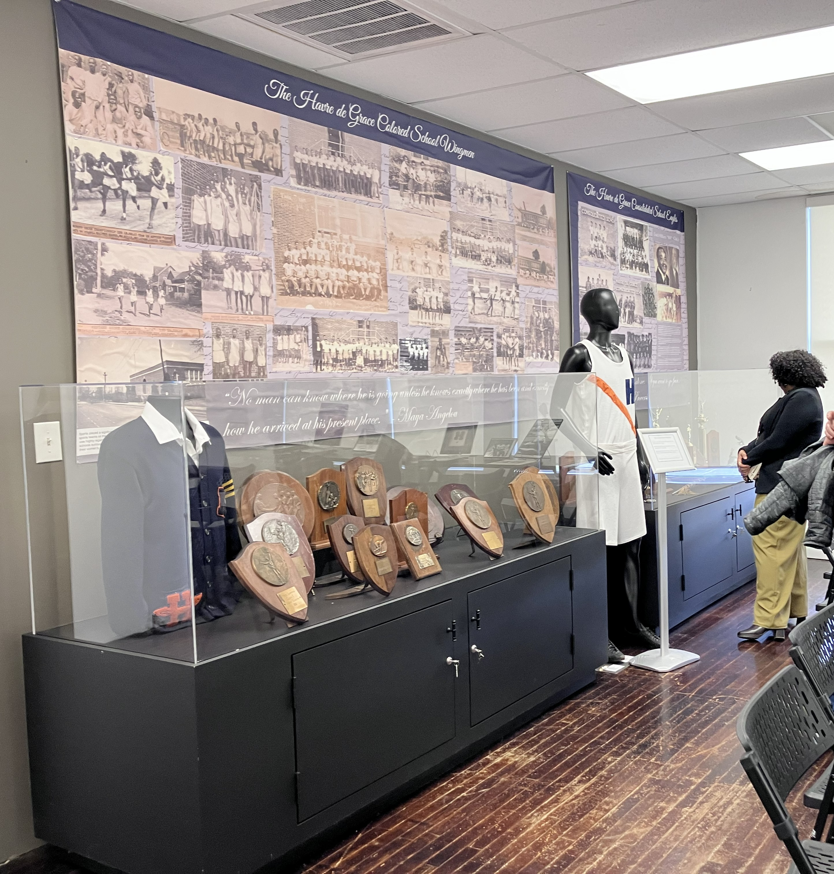
Tier 1: Organizational Capacity
Up to $50,000
New paid staff or consultant
Directly advance the preservation, stewardship, or interpretation of African American History and Culture in Maryland
Ability to keep the position after the grant ends
Havre de Grace Colored School, Harford County

Slide 7
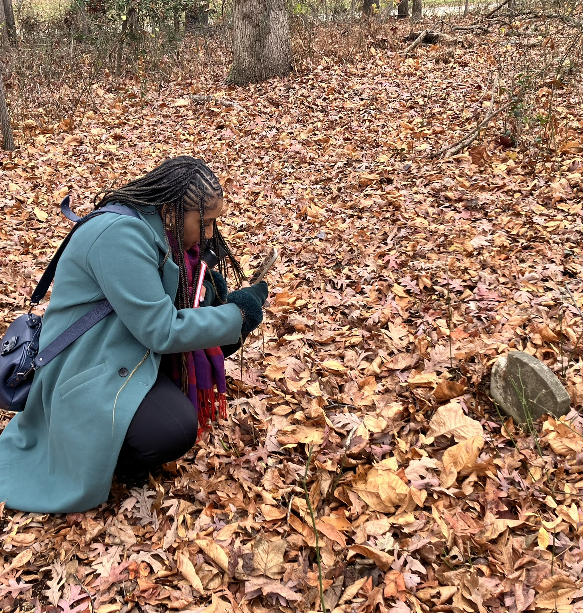
Tier 2: Project Planning
Up to $25,000
Funds plans, studies, and strategies that guide how to preserve, protect, manage, or interpret African American History and Culture in Maryland
Must produce a final written deliverable
Boys Village Cemetery, Prince George's County

Slide 8
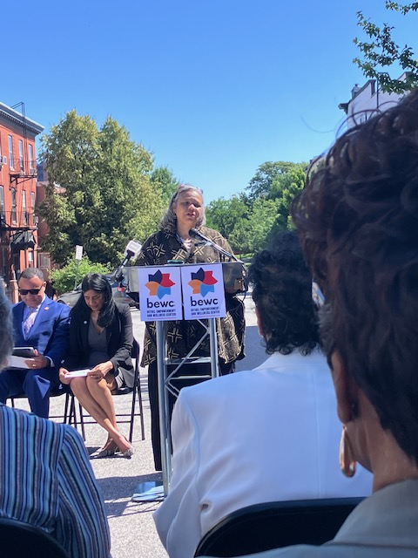
Tier 3: Programming and Interpretation
Up to $25,000
Funds education, documentation, storytelling, and the arts
Supports community events and educational programming
Connecting communities to African American History and Culture in Maryland
Bethel Wellness and Empowerment Center, Baltimore City

Slide 9
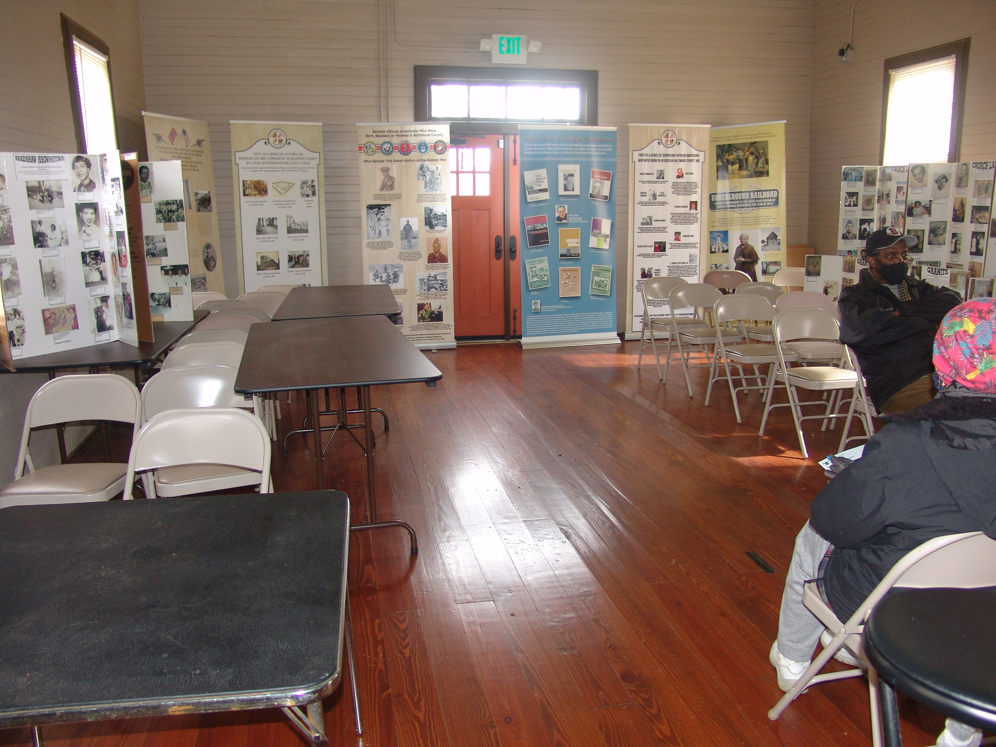
Project Considerations
Indirect costs
Ineligible Work
Letters of Support
Photos and Images
Estimates
Operating budget
Diggs-Johnson Museum, Baltimore County

Slide 10
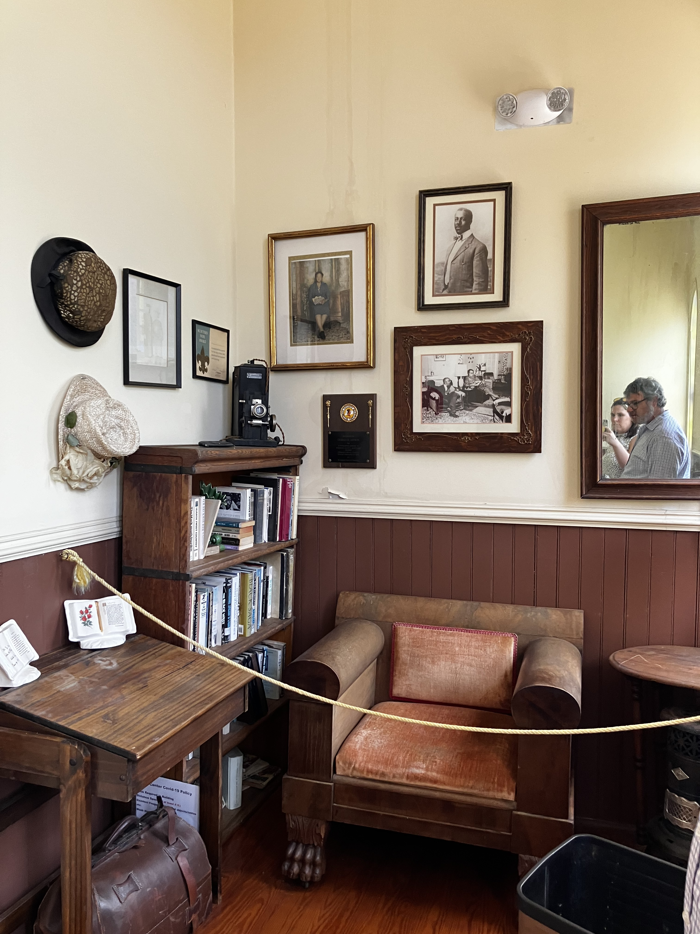
How to Apply?
Read the Grant Guidelines
Check your SDAT status and registration with the MD Secretary of State
Gather application materials and organizational documents
Develop your request and budget
Keep the deadline (Nov 20) in mind!
Apply ONLINE from the program website
Chipman Center, Wicomico County

Slide 11
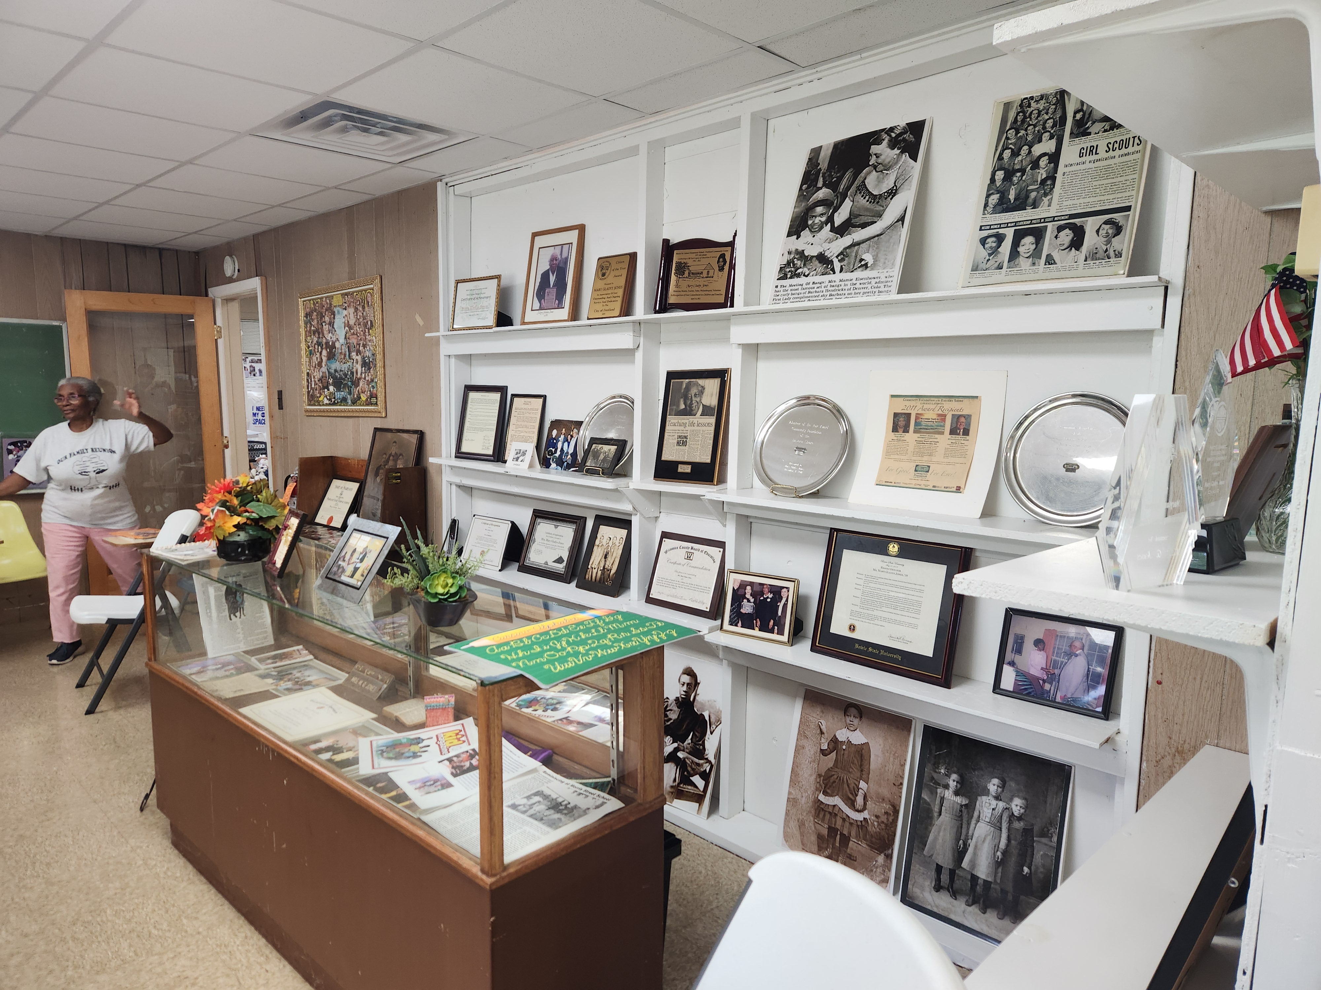
Mission and Organizational Capacity
Background
Years in Operation
Mission Statement
Organization/Institution Type
Staffing & Volunteer Support
Accreditations
Collections and Exhibits
Fruitland Community Center, Wicomico County

Slide 12
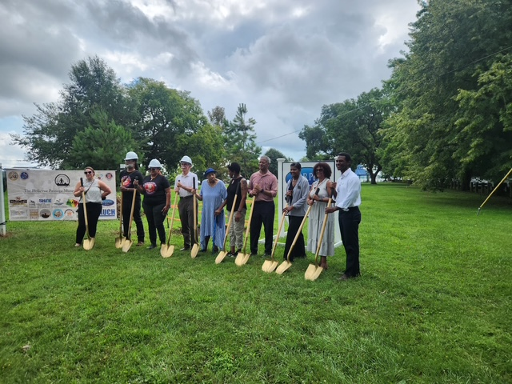
Programming and Impact
Current Goals
Programming
Community Impact
Partnerships
Current and anticipated audiences
Bellevue Passage Museum, Talbot County

Slide 13
Grant Request
What is the total request?
Tier 1 can request up to $50,000, Tiers 2 & 3 can request up to $25,000
Requests should be in $1,000 increments
Matches aren't required, but encouraged
Plan for long-term sustainability

Slide 14
Funding Requested Questions by Tier
Tier 1 - Organizational Capacity:
  How you would use an organizational capacity grant?
  Detail all planned activities
  Justify how the funding will strengthen your organizational effectiveness.
Tier 2 - Project Planning
  How you would use a project planning grant?
  Identify a specific deliverable
  How will the plan advance the project, program, or site's goals.
Tier 3 - Programming & Interpretation
  How you would use a programming and interpretation grant?
  Describe specific activities.
  How the proposed programming help better understand African American history in Maryland.

Slide 15
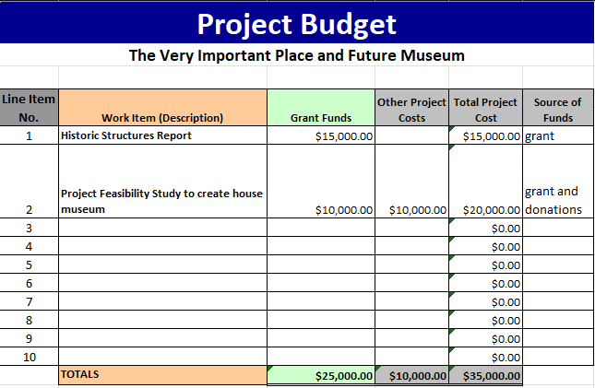
Budget Spreadsheet

Slide 16
Grant Administration Schedule
November 20, 2026: Applications due
11:59 pm EST
The following dates are approximate:
  March 2027: Grant Awards announced
  April 2027: Grant Agreements completed
  April 2028: Project completed

Slide 17
What else should I know if I get a grant?
All grantees will sign a grant agreement;
Grant funds can only pay for services hired through a competitive bidding process approved by MHT;
Payments are made as your project progresses;
All grantees must provide mid-grant and final reports.

Slide 18
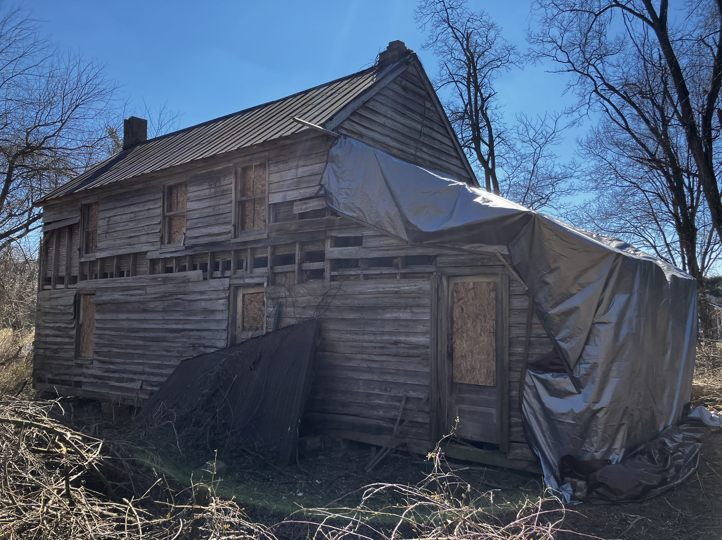
Selection Criteria
Historical Significance
Community Benefit
Clarity & Feasibility
Organizational Capacity
Long Term Impact
Mander House, Kent County

Slide 19
Contact Info
Alexandria Anderson
Research Specialist, MCAAHC
alexandria.anderson@maryland.gov
410-793-7267
Stacy Montgomery
Capital Programs Administrator, MHT
stacy.montgomery@maryland.gov
410-697-9559
Program Website

